Slide 1
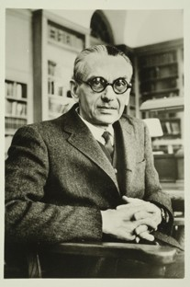
First Order Logic

Slide 2
This Lecture
Last time we talked about propositional logic, a logic on simple statements.
This time we will talk about first order logic, a logic on quantified statements.
First order logic is much more expressive than propositional logic.
The topics on first order logic are:
Quantifiers
Negation
Multiple quantifiers
Arguments of quantified statements

Slide 3
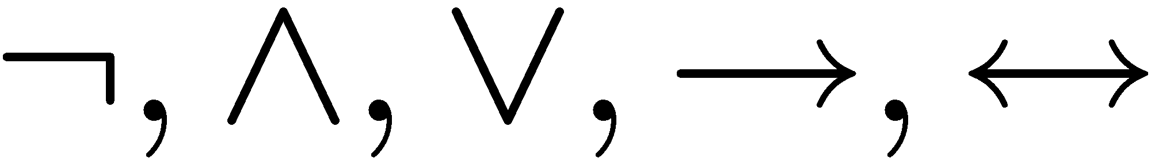
Limitation of Propositional Logic
Propositional logic – logic of simple statements
How to formulate Pythagoreans’ theorem using propositional logic?
b
c
a
How to formulate the statement that there are infinitely many primes?

Slide 4
Predicates
Predicates are propositions (i.e. statements) with variables
Example:
P (x,y) ::=
x + 2 = y
x = 1 and y = 3: P(1,3) is true
x = 1 and y = 4: P(1,4) is false
¬P(1,4) is true
When there is a variable, we need to specify what to put in the variables.
The domain of a variable is the set of all values
that may be substituted in place of the variable.

Slide 5
Set
We have not defined formally what is a set, and will do so later in the course.
For now, it is enough for our discussion to recall some well-known examples.
Z: the set of all integers
Z⁺: the set of all positive integers
Z⁻: the set of all negative integers
R: the set of all real numbers
Q: the set of all rational numbers

Slide 6
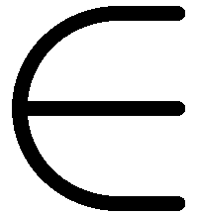
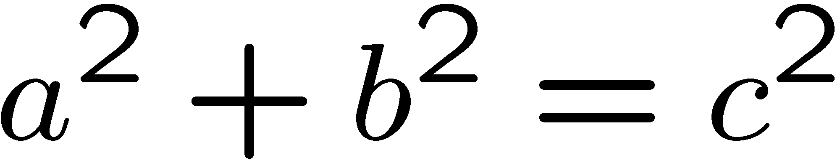
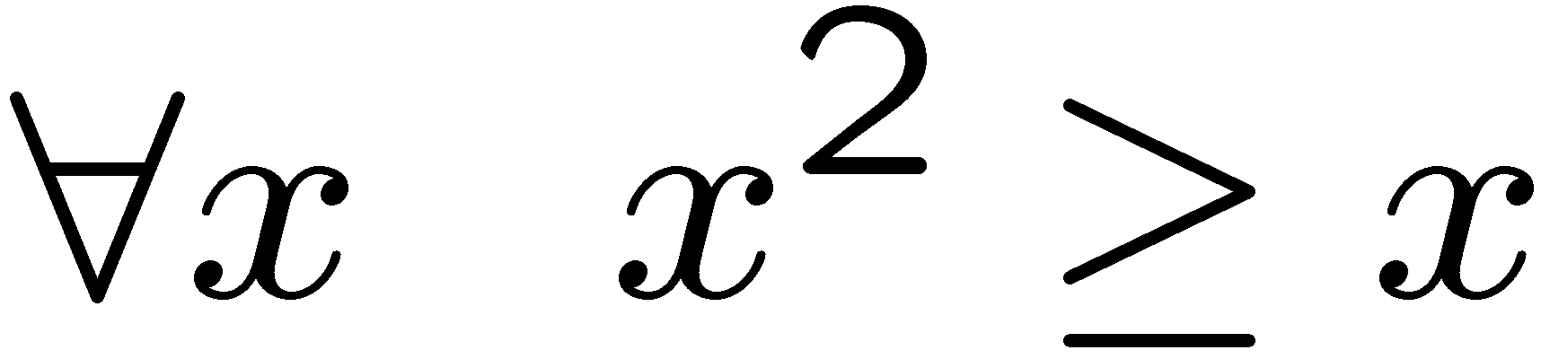
The Universal Quantifier
The universal quantifier
∀x
for ALL x
Example:
∀ x Z⁺ P(x) means P(1)  P(2)  P(3)  …
Example:
∀ x Z ∀ y Z, x + y = y + x.
c
Pythagorean’s theorem
b
a
Example:
This statement is true if the domain is Z, but not true if the domain is R.
The truth of a predicate depends on the domain.

Slide 7
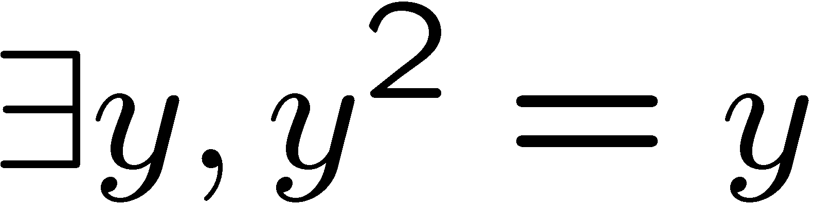
The Existential Quantifier
∃y
There EXISTS some y
∃ y Z⁺ P(y) means P(1)  P(2)  P(3)  …
e.g.
The truth of a predicate depends on the domain.
Domain
Truth value
integers 
T
positive integers ⁺
T
negative integers ⁻
F
negative reals R⁻
T

Slide 8
Translating Mathematical Theorem
Fermat (1637): If an integer n is greater than 2,
then the equation a^{n} + b^{n} = c^{n} has no solutions in non-zero integers a, b, and c.
Andrew Wiles (1994)
http://en.wikipedia.org/wiki/Fermat's_last_theorem

Slide 9
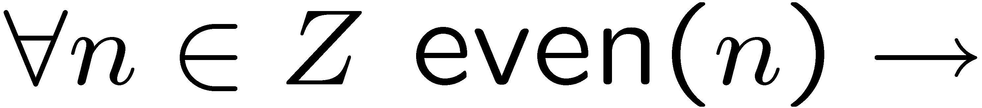
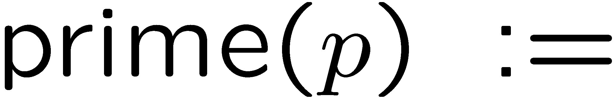
Translating Mathematical Theorem
Goldbach’s conjecture: Every even number is the sum of two prime numbers.
Suppose we have a predicate prime(x) to determine if x is a prime number.
How to write prime(p)?

Slide 10
Quantifiers
Negation
Multiple quantifiers
Arguments of quantified statements

Slide 11
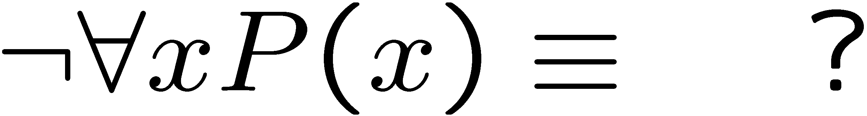
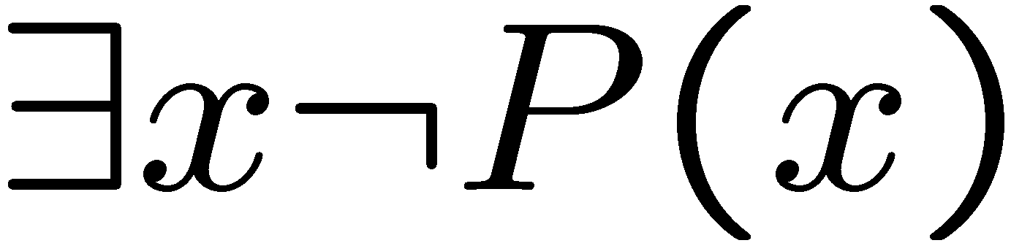
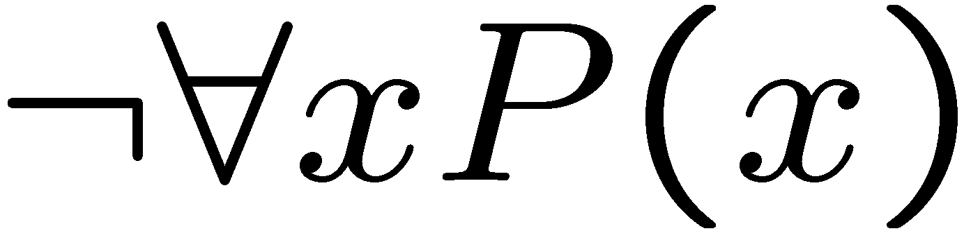
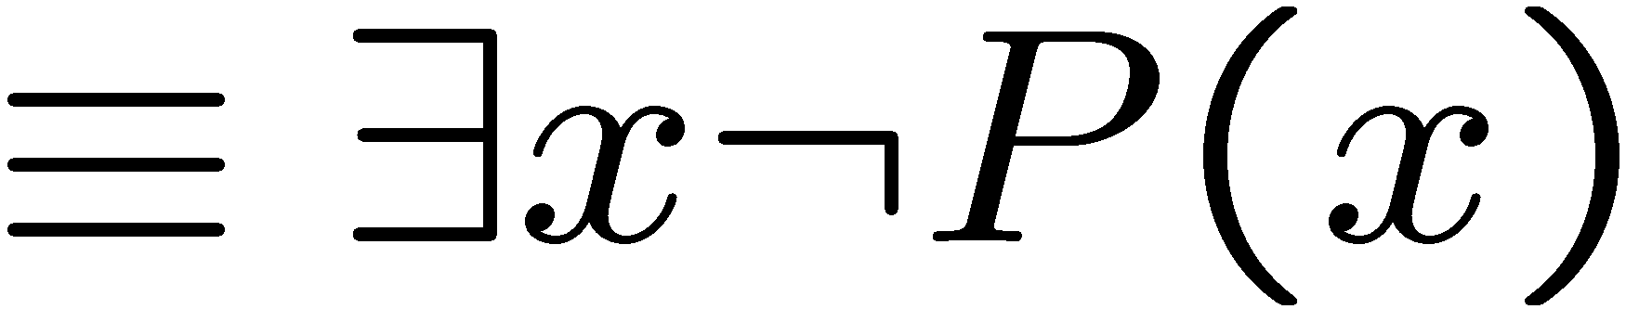
Negations of Quantified Statements
Everyone likes football.
What is the negation of this statement?
Not everyone likes football = There exists someone who doesn’t like football.
(generalized) DeMorgan’s Law
Say the domain has only three values.
The same idea can be used to prove it for any number of variables.

Slide 12
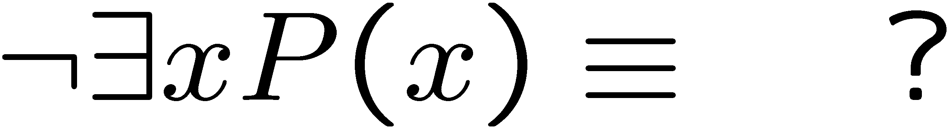
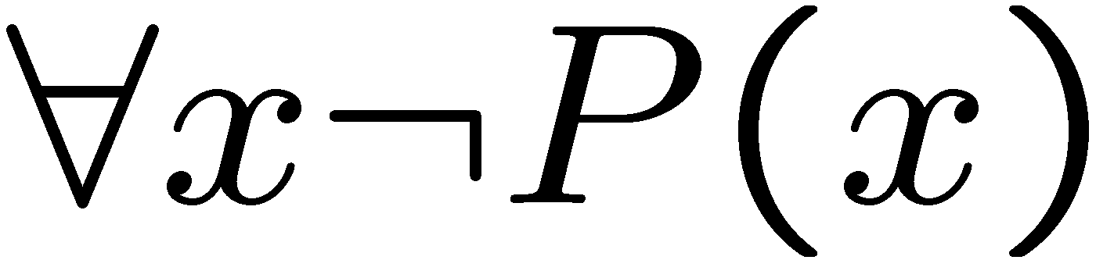
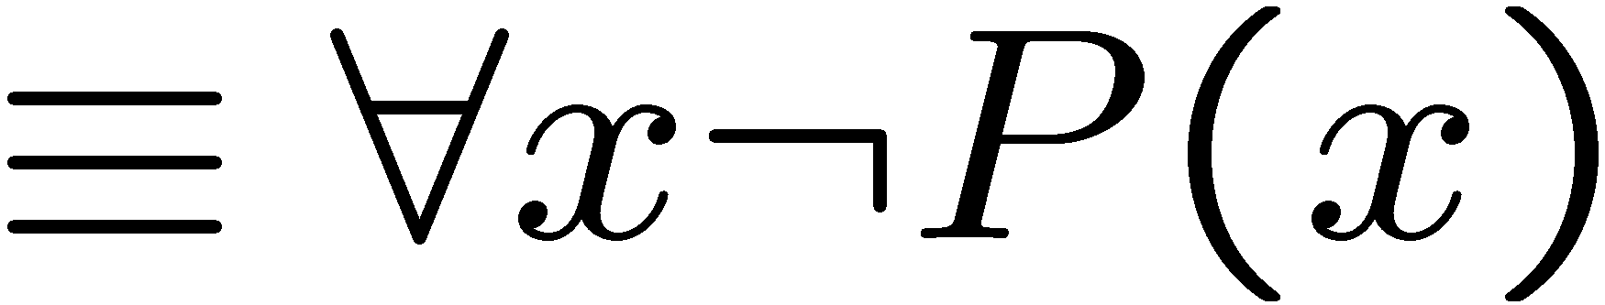
Negations of Quantified Statements
There is a plant that can fly.
What is the negation of this statement?
Not exists a plant that can fly = every plant cannot fly.
(generalized) DeMorgan’s Law
Say the domain has only three values.
The same idea can be used to prove it for any number of variables.

Slide 13
Quantifiers
Negation
Multiple quantifiers
Arguments of quantified statements

Slide 14
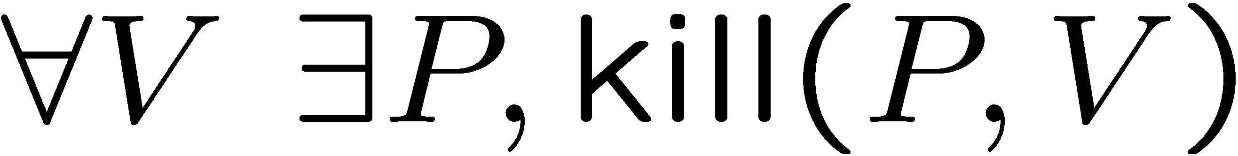
Order of Quantifiers
There is an anti-virus program killing every computer virus.
How to interpret this sentence?
For every computer virus, there is an anti-virus program that kills it.
For every attack, I have a defense:
against MYDOOM, use Defender
against ILOVEYOU, use Norton
against BABLAS, use Zonealarm …
 is expensive!

Slide 15
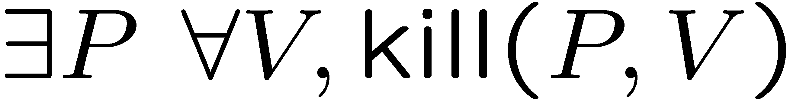
Order of Quantifiers
There is an anti-virus program killing every computer virus.
How to interpret this sentence?
There is one single anti-virus program that kills all computer viruses.
I have one defense good against every attack.
Example: P is CSE-antivirus,
protects against ALL viruses
That’s much better!
Order of quantifiers is very important!

Slide 16
Order of Quantifiers
Let’s say we have an array A of size 6x6.
1
 | 1 | 1 |  | 1
 |  | 1
 |  | 1 |  | 1
 |  |  | 1
 |  | 1
Then this table satisfies the statement.

Slide 17
Order of Quantifiers
Let’s say we have an array A of size 6x6.
1
 | 1 | 1 |  | 1
 |  | 1
 |  | 1 |  | 1
 |  |  | 1
 |  | 1
But if the order of the quantifiers are changes,
then this table no longer satisfies the new statement.

Slide 18
Order of Quantifiers
Let’s say we have an array A of size 6x6.
1 | 1 | 1 | 1 | 1 | 1
To satisfy the new statement, there must be a row with all ones.

Slide 19
Questions
Are these statements equivalent?
Are these statements equivalent?
Yes, in general, you can change the order of two “foralls”,
and you can change the order of two “exists”.

Slide 20
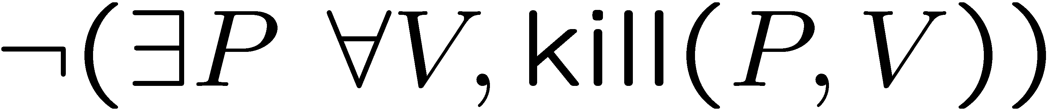
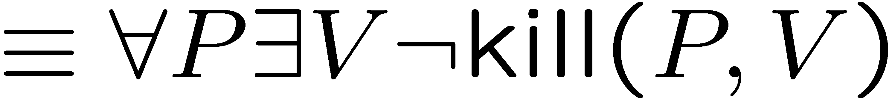
More Negations
There is an anti-virus program killing every computer virus.
What is the negation of the above sentence?
For every program, there is some virus that it can not kill.

Slide 21
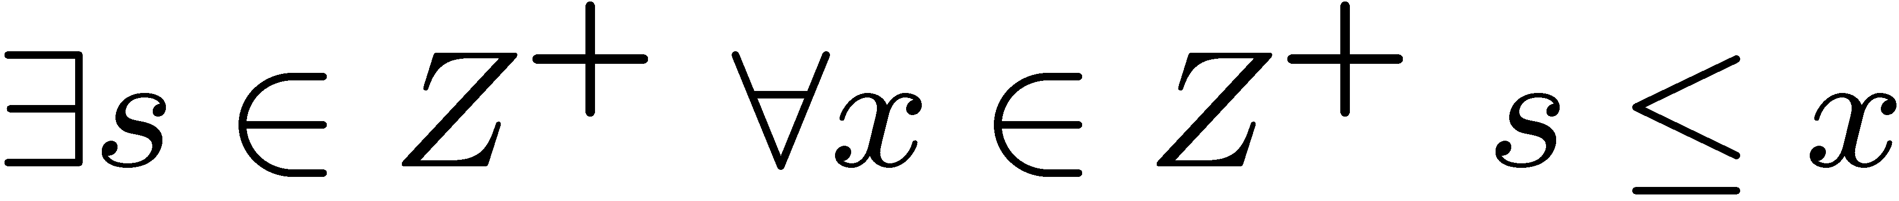
Exercises
There is a smallest positive integer.
There is no smallest positive real number.
In words, there is always a larger positive real number.

Slide 22
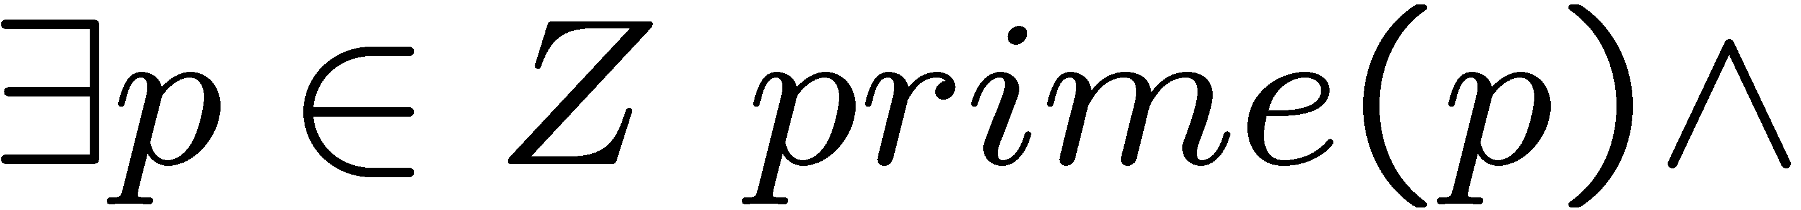
Exercises
There are infinitely many prime numbers.
In words, there exists a prime (first part)
and there is no largest prime (second part, similar to the previous question).
Formulating sentences using first order logic is useful in logic programming
and database queries.

Slide 23
Quantifiers
Negation
Multiple quantifiers
Arguments of quantified statements

Slide 24
Predicate Calculus Validity
Propositional validity
True no matter what the truth values of A and B are
Predicate calculus validity
∀z [Q(z)  P(z)] → [∀x.Q(x)  ∀y.P(y)]
True no matter what
the Domain is,
or the predicates are.
That is, logically correct, independent of the specific content.

Slide 25
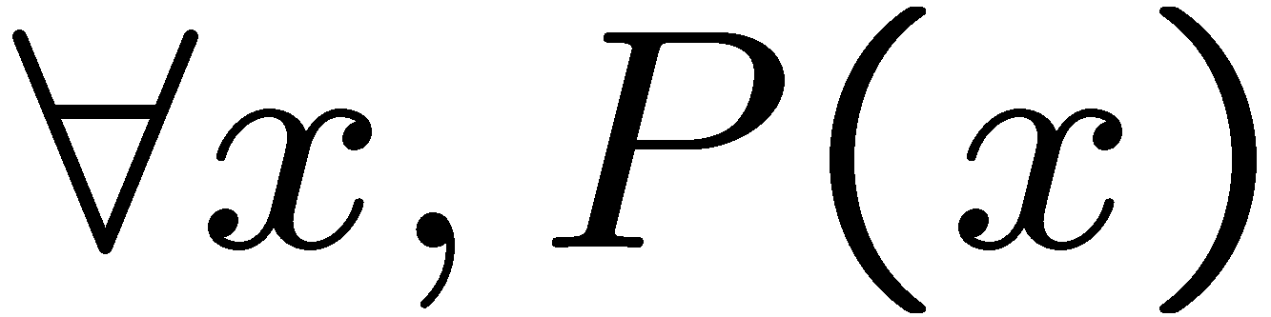
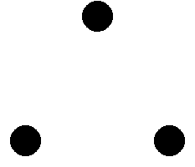
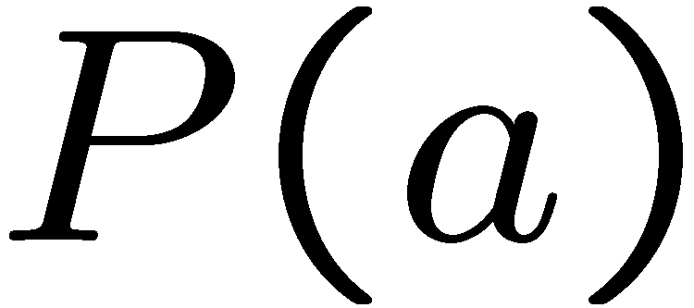
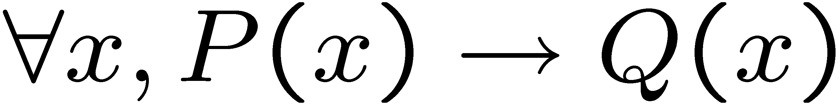
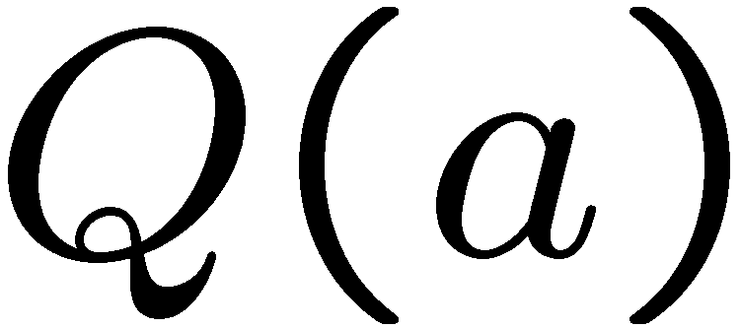
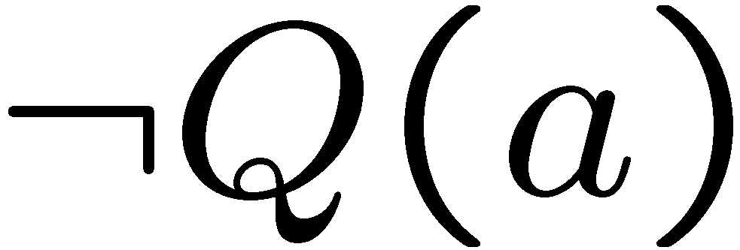
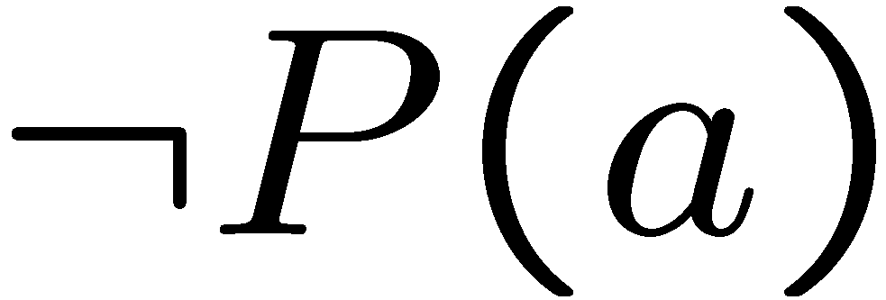
Arguments with Quantified Statements
Universal instantiation:
Universal modus ponens:
Universal modus tollens:

Slide 26
Universal Generalization
valid rule
providing c is independent of A
Informally, if we could prove that R(c) is true for an arbitrary c
(in a sense, c is a “variable”), then we could prove the for all statement.
e.g. given any number c, 2c is an even number
=> for all x, 2x is an even number.
Remark: Universal generalization is often difficult to prove, we will
introduce mathematical induction to prove the validity of for all statements.

Slide 27
Valid Rule?
∀z [Q(z)  P(z)] → [∀x.Q(x)  ∀y.P(y)]
Proof: Give countermodel, where
∀z [Q(z)  P(z)] is true,
but ∀x.Q(x)  ∀y.P(y) is false.
In this example, let domain be integers,
Q(z) be true if z is an even number, i.e. Q(z)=even(z)
P(z) be true if z is an odd number, i.e. P(z)=odd(z)
Find a domain,
and a predicate.
Then ∀z [Q(z)  P(z)] is true, because every number is either even or odd.
But ∀x.Q(x) is not true, since not every number is an even number.
Similarly ∀y.P(y) is not true, and so ∀x.Q(x)  ∀y.P(y) is not true.

Slide 28
Valid Rule?
∀z D [Q(z)  P(z)] → [∀x D Q(x)  ∀y D P(y)]
Proof: Assume ∀z [Q(z)P(z)].
So Q(z)P(z) holds for all z in the domain D.
Now let c be some element in the domain D.
So Q(c)P(c) holds (by instantiation), and therefore Q(c) by itself holds.
But c could have been any element of the domain D.
So we conclude ∀x.Q(x). (by generalization)
We conclude ∀y.P(y) similarly (by generalization). Therefore,
∀x.Q(x)  ∀y.P(y) QED.

Slide 29
Summary
This finishes the introduction to logic, half of the first part.
In the other half we will use logic to do mathematical proofs.
At this point, you should be able to:
Express (quantified) statements using logic formula
Use simple logic rules (e.g. DeMorgan, contrapositive, etc)
Fluent with arguments and logical equivalence

Slide 30
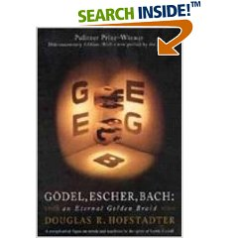
(Optional) More About Logic
Ideally, we can come up with a “perfect” logical system, which is consistent
(not having contradictions) and is powerful (can derive everything that is true).
But Gödel proved that there is no perfect logical system.
This is called the Gödel’s incompleteness theorem.
It is an important and surprising result in mathematics.
The ideas in his proof are also influential in computer science,
to prove that certain problem is not computable,
e.g. it is impossible to write a program to check whether
another program will loop forever on a particular input
(i.e. a perfect debugger doesn’t exist).

Slide 31
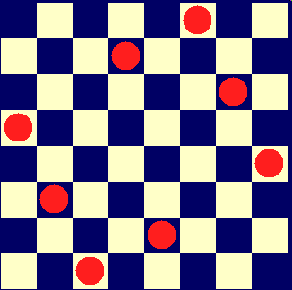
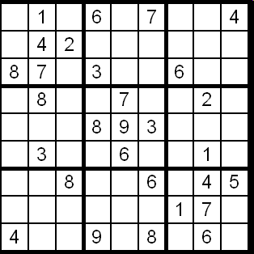
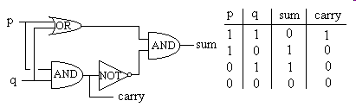
Applications of Logic (Optional)
Logic programming
Database
Digital circuit
solve problems by logic
making queries, data mining

